Slide 1
Firewall Policies
Linux 1 Day 3

Slide 2
Today’s Objectives
By the end of class, you will be able to:
Develop firewall policies
Implement firewall rules with ufw
Interpret iptables rules

Slide 3
Strong security requires insight into the contents of packets traveling on the wire.

Slide 4

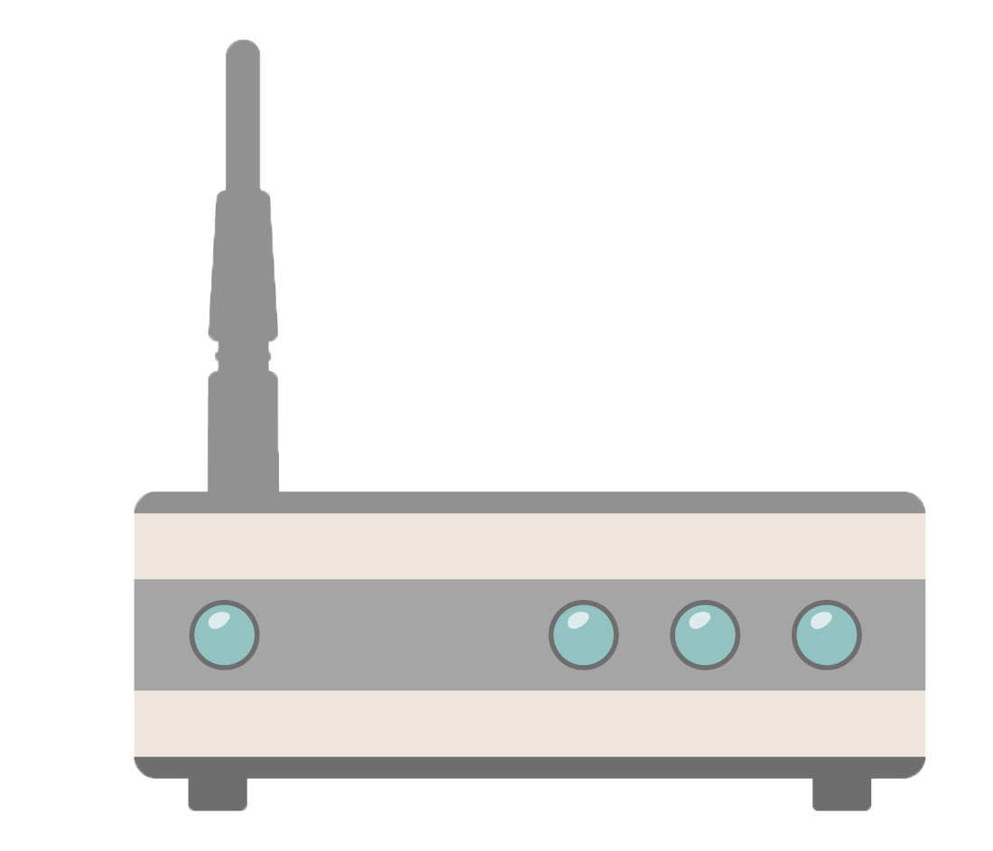


Host Firewall: Filter packets entering / exiting a single host on a network.
Network Firewall: Filter packets entering / exit a network from the public Internet.

Slide 5
Firewalls
What firewalls can inspect:
The source/destination IP/MAC Addresses: does the packet comes from a device in a trusted subnet or is the response is to a request made from a trusted device
A packet's TCP flags: does the packet contain TCP flag settings.
Whether the data in the packet is malformed or corrupted
The rate with which a given host is sending packets

Slide 6
Ufw

Slide 7

Ufw (Uncomplicated FireWall)
We’ll use ufw for tasks like:
Deny incoming packets based on certain conditions, such as source IP, malformed TCP flags, etc.
Only allow the machine to send data for specific protocols, such as SSH.
Rate-limit communications from a source IP to a destination port to the host.
ufw is a firewall configuration utility found on many Linux machines.

Slide 8
ufw Demo
What we’ll cover in the next demo:
Set “default” rules to deny all outgoing / incoming traffic from all ports
Set a specific rule to allow HTTP traffic, so we can browse the web.
Turn on logging to keep track of all packets that the firewall drops.
Verify firewall settings.

Slide 9
ufw commands
enable: Starts the firewall, and causes it to start on system startup.
disable: Stops the firewall.
default: Allows administrators to set default rules, which apply to all packets except for those that have a specific rule set up for them already.
logging: Tells UFW how much information to log. When logging is enabled, UFW keeps information about every packet that it drops. The available levels are off, low, medium, and high. Increasing log levels causes UFW to save more information about packets that it drops.
allow: Used to set a rule to allow packets into/out of specific ports.
deny: Used to set a rule to allow packets into/out of specific ports. If UFW drops a packet due to a deny rule, it throws it away, and sends no response to the source machine.
reject: Reject rules are like deny rules, except they cause UFW to drop the packet and send an error message back to the source machine. This is somewhat less secure than a deny rule, because it reveals something about your firewall configuration to the source host.

Slide 10
Blocking a Host and Testing Access Controls

Slide 11
Activity: Blocking a Host and Testing Access Controls
In this activity, you will review how to use wireshark to monitor traffic and use ufw to block web traffic to / from the VM.
Instructions sent via Slack.
20 Minutes

Slide 12
Blocking a Host
and
Testing Access Controls

Slide 13
Developing Policies with UFW

Slide 14
Firewall Design Principles
By default, well-configured firewalls should drop packets by default, only allowing access or egress if specified for particular ports and protocols.
Traffic should only be allowed to / from ports that are required by services the machine is expected to provide.
Document the services that the machine is expected to furnish, and implement rules clearing only the ports required.
Traffic should be allowed from as few hosts as possible. Ideally, this means allowing connections only from known IP address.
If configuring an intranet, restrict connections to machines on the local subnets.
If configuring a public server, you can’t restrict connecting IP addresses as effectively, so it’s important to harden the host thoroughly.

Slide 15
Firewall Design Principles
When configuring a new firewall, start from scratch.
A well-configured firewall should drop packets by default, only allowing access or egress if it's been explicitly enabled for a particular port and/or protocol.
Drop Incoming: ufw default deny incoming
Drop Outgoing: ufw default deny outgoing

Slide 16
Firewall Traffic
Traffic should be allowed only to/from ports that are required by services the machine is expected to provide. This minimizes the host's potential attack surface.
You determine which ports to allow by documenting the services the machine is expected to furnish, and implementing rules clearing only the ports they require.
Traffic should be allowed from as few hosts as possible. Ideally, this means allowing connections only from known IP addresses.
In the event you're configuring an intranet, you'll likely restrict connections to machines on the local subnet(s).
If you're configuring a public server, you can't restrict connecting IP addresses as effectively, so it's particularly important to harden the host as thoroughly as possible.

Slide 17
Activity: Setting and Testing Firewall Rules
In this activity, you will implement a firewall policy by setting rules with ufw.
Instructions sent via Slack.
20 Minutes

Slide 18
Firewall Rules

Slide 19
Introducing iptables

Slide 20
Iptables are a standard firewall included in most Linux distributions.

Slide 21
Iptables
Iptables match each packet that crosses the networking interface against a set of rules, then decides an action.
Table 1 (Filter)
Rules: Conditions under which a server should accept or drop a packet.
Chain: A series of rules that a firewall applies to network packet.
Tables: A collection of chains that serve a related purpose.
Chain 1 (Forward)
Rule 1
Rule 2
Rule 3
Chain 2
Rule 1
Rule 2
Rule 3

Slide 22
Input, Output, Forward
Iptables have three principle chains:
Input chains: determines whether the firewall accepts or drops incoming packets.
Output Chains: Determines whether the firewall accepts or drops outbound connections.
Forward chains: Determines whether the firewall will act as a router and forward the packet to its destination.

Slide 23
INPUT Chain
Iptables -A INPUT -p tcp --syn --dport 80 -m state --state NEW -j ACCEPT
Iptables -A INPUT -p tcp --syn --dport 443 -m state --state NEW -j ACCEPT
Iptables -A INPUT -p tcp --dport 4321 -i eth0 -s $INT_NET -j ACCEPT

Slide 24
INPUT Chain
Iptables -A OUTPUT -p tcp --dport 21 --syn -m state --state NEW -j ACCEPT
Iptables -A OUTPUT -p tcp --dport 22 --syn -m state --state NEW -j ACCEPT
Iptables -A OUTPUT -p tcp --dport 25 --syn -m state --state NEW -j ACCEPT

Slide 25
Filter Table (Diagram)
KERNEL
route?
FORWARD
Local Process
INPUT
OUTPUT

Slide 26
Activity: Interpreting iptables Rules
In this activity, you will partner up to interpret common firewall rulesets, extracted from real configurations.
Instructions sent via Slack.
15 Minutes

Slide 27
Interpreting iptables Rules

Slide 28
Today’s Objectives
By the end of class, you will be able to:
Develop firewall policies
Implement firewall rules with ufw
Interpret iptables rules

